Slide 1

Maxis Graduate Programme- Software Engineer Case Study
Name: Ahmad ‘Asim bin Ahmad Izhar
Programme: Digital Development Graduate Programme

Slide 2


Problem Statement
One of Maxis’s big retail client would like to invest and innovate their shop by using Internet of Things
Come out with solution or proposal on how this Internet of Things can be implement to client’s shop so they can understand foot traffic of shoppers across the nation.
Convince the client that the proposal or solution that have been proposed can be realised.

Slide 3
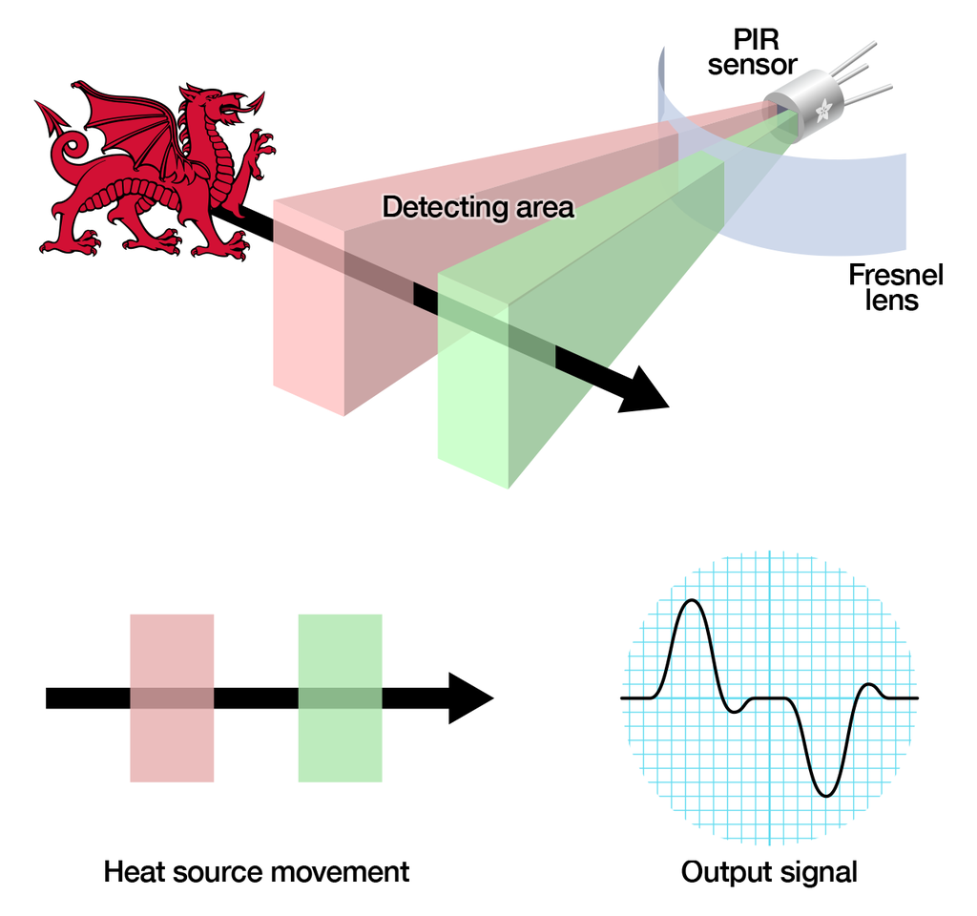
Proposed Solution
PIR Sensor can be used as foot traffic system.
PIR Sensor detect movement from infrared radiation produce by human.

Slide 4
02
04
Customer walk through entry door
Customer start shopping
01
03
05
Customer stand outside of the shop
Foot traffic system (PIR Sensor) counting people
Customer exit

Slide 5
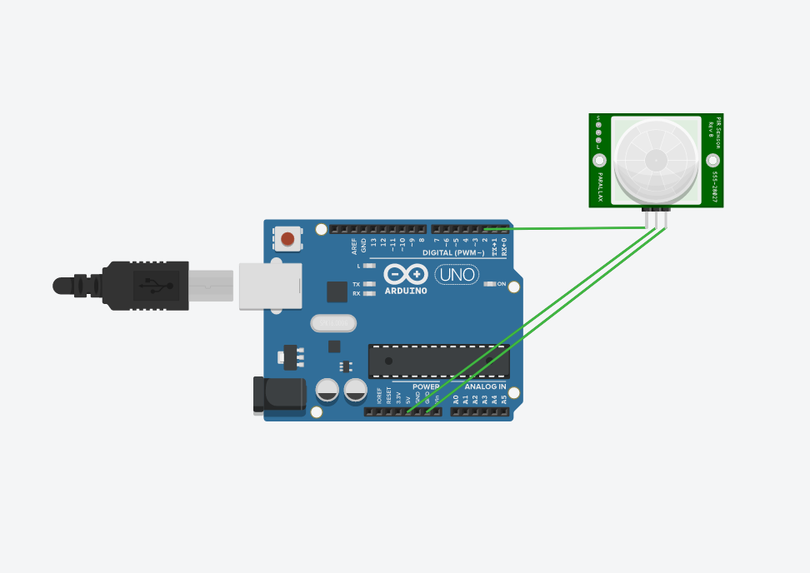
Prototype Design

Slide 6
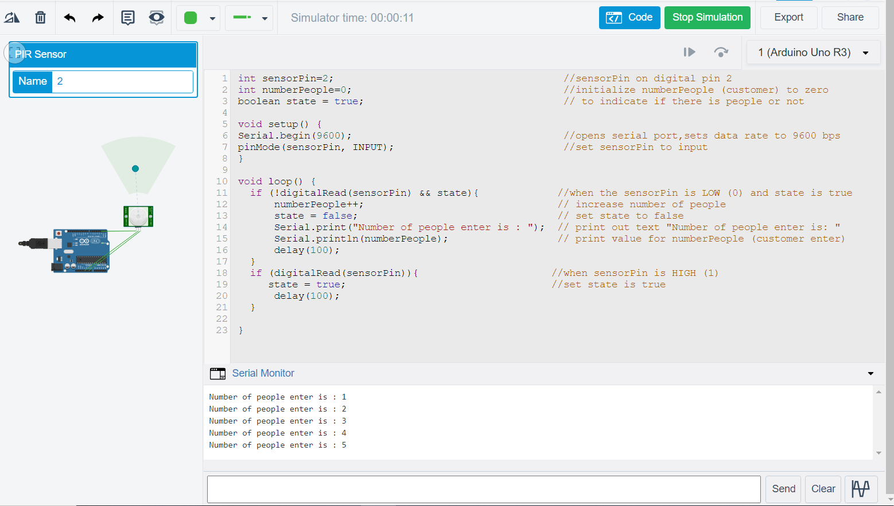
Prototype Simulation

Slide 7
Conclusion
Successfully provide a solution for the client to innovate their shop using Internet of Things.
The client will be able to implement foot traffic system on their shop’s entrance.
This foot traffic system can be monitored through computer or access remotely through the cloud.

